Slide 1
Lumière de Vie®護膚美麗革命
Lumière de Vie®
Helen Lin
專業經理級 Professional Coordinator
四個佣金週期共賺取HK$34,500
HK$34,500 in 4 Commission weeks
Angie Chou
主管經理級 Master Coordinator
四個佣金週期共賺取HK$16,100
HK$16,100 in 4 Commission weeks
本簡報中提到的收入等級純屬舉例說明，無意代表美安香港經銷商的一般收入，也無意表示任何經銷商皆可賺取同等收入。美安香港經銷商的成功與否，取決於其在發展事業時的努力、才能與投入程度。The income levels mentioned in the following presentation are for illustration purposes only. They are not intended to represent the income of a typical Market Hong Kong Distributor, nor are they intended to represent that any given Independent Distributor will earn income in that amount. The success of any Market Hong Kong Independent Distributor will depend upon the amount of hard work, talent, and dedication which he or she devotes to building his or her Market Hong Kong Business.

Slide 2
極緻妍亮護膚系列

Slide 3
Put life and light into your skin with Lumière de Vie
Lumiére de Vie®
極緻妍亮護膚系列
激活肌膚散發傳奇亮澤的奧秘

Slide 4
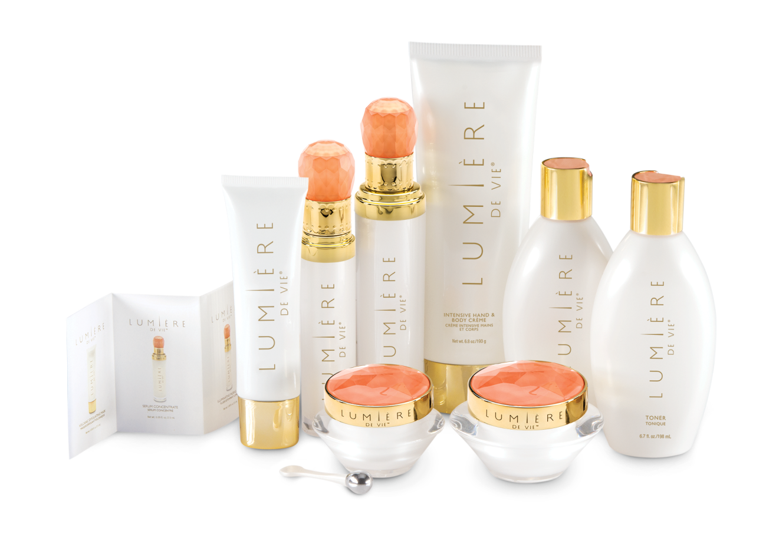

Slide 5
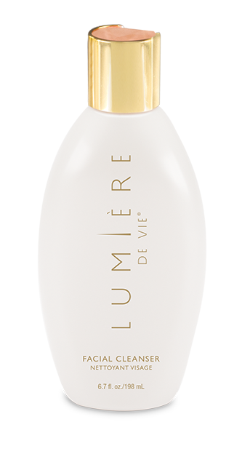
第1步：極緻妍亮潔面乳 step 1: Facial Cleanser
主要成份：
泛醇、尿囊素
效果：
去角質並潔淨毛孔，清除污垢及多餘油脂
徹底潔淨肌膚，為肌膚注入再生活力
有助改善肌膚粗糙及乾燥表面
KEY INGREDIENTS:
Panthenol (Vitamin B5), Allantoin
Results you can expect:
Exfoliates skin to cleanse pores and remove impurities and excess oils
Thoroughly cleanses the skin, leaving it feeling refreshed and invigorated
Helps reduce the appearance of rough and dry skin
HK12207; DC$210.00; SR$293.00; BV: 20

Slide 6
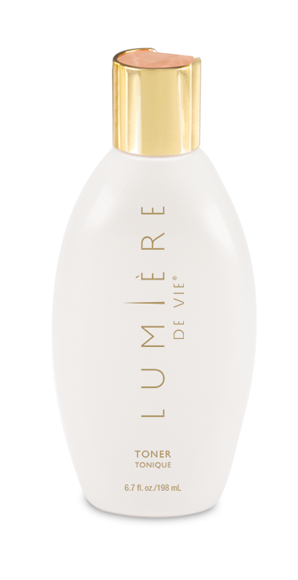
第2步：極緻妍亮爽膚水 step 2: TONER
主要成份：
乳酸、尿囊素
效果：
有助改善肌膚粗糙和乾燥外表，令肌膚外表更柔軟嫩滑
支援健康的肌膚含水量，令肌膚散發年輕光彩
去除角質潔淨毛孔，並清除肌膚上的雜質和多餘油脂
KEY INGREDIENTS:
Lactic Acid, Allantoin
Results you can expect:
Helps to reduce the appearance of rough, dry skin, leaving it looking softer and smoother
Supports healthy skin hydration, for a younger-looking, radiant complexion
Exfoliates skin to cleanse pores, and remove impurities and excess oils
HK12208; DC$185.00; SR$260.00; BV: 18

Slide 7
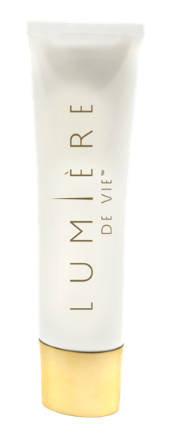
第3步：極緻妍亮火山泥去角質面膜
step 3: VOLCANIC EXFOLIATING MASK
主要成份：
PerfectionPeptide P3、火山泥（浮石）、尿囊素、乳酸 、甜杏仁油
效果：
尿囊素、甜杏仁油、橄欖油和葡聚多醣體等成份有助紓緩肌膚
綠茶及歐洲藍莓中的抗氧化成份有助抵抗環境壓力對肌膚造成的影響
KEY INGREDIENTS:
PerfectionPeptide P3, Volcanic Sand (Pumice), Allantonin, Lactic Acid, Sweet Almond Oil
Results you can expect
Soothes the skin with allantoin, sweet almond oil, olive fruit oil, and beta-glucan
Antioxidants from green tea and bilberry help protect against the effects of environmental stress on the skin
HK12202; DC$305.00; SR$425.00; BV: 32

Slide 8
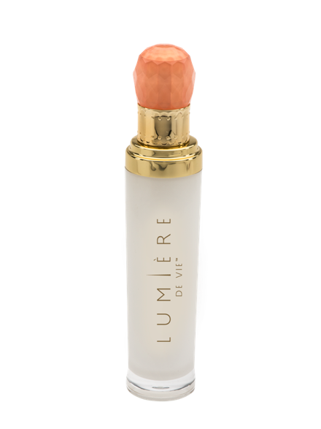
第3步：極緻妍亮淡斑液 step 3: ILLUMINATING FADING FLUID
主要成份：
Illumiscin、Synovea HR（乙基間苯二酚）、乙醯葡萄糖胺、尿囊素、玻尿酸鈉
效果：
淡化黑斑及色斑，紓緩皮膚泛紅現象
使肌膚看來透亮年輕
幫助保濕，令肌膚外表更柔嫩軟滑
KEY INGREDIENTS:
Illumiscin, Synovea HR, Acetyle Glucosamine, Allantoin, Sodium Hyaluronate
Results you can expect:
Minimizes the appearance of dark spots, age spots and redness
Promotes a more radiant, younger-looking complexion
Moisturizes to give skin a smoother and softer appearance
HK12203; DC$350.00; SR$490.00; BV: 35

Slide 9
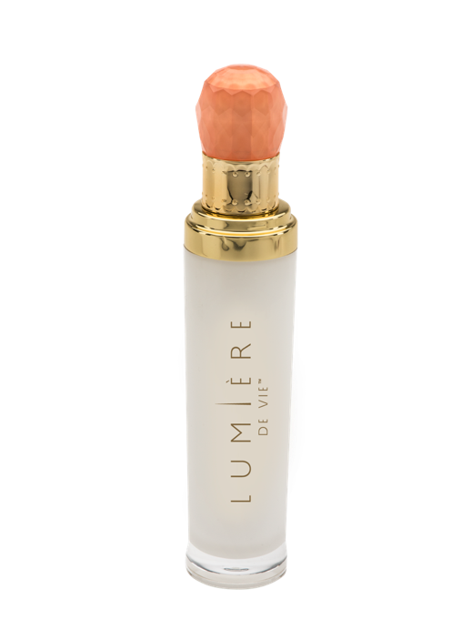
第3步：極緻妍亮精華液 step 3: SERUM CONCENTRATE
主要成份：
Juvenessence® （海藻萃取物）、Sytenol® A （補骨脂酚）、Synovea® HR（乙基間苯二酚）、雷公根（積雪草）萃取物
效果：
有助肌膚緊緻光滑
支援正常健康的皮膚膠原蛋白
內含的抗氧化物有助抵抗環境壓力帶來的影響
KEY INGREDIENTS:
Juvenessence® (Algae Extract), Sytenol® A, Synovea® HR, Centella asiatica Extract
Results you can expect:
Helps the skin to look firmer and smoother
Supports normal, healthy skin collagen
Antioxidants help protect against the effects of environmental stresses
HK12204; DC$495.00; SR$690.00; BV: 50

Slide 10
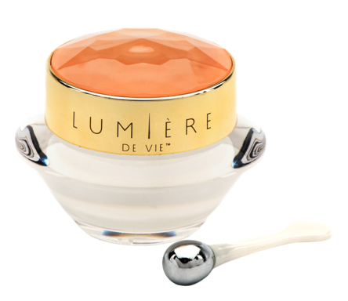
第4步：極緻妍亮眼霜
step 4: EYE BALM
主要成份：
Pinoxide®、乳木果油、甘油、角鯊烷
效果：
減淡黑眼圈
緊緻眼底肌膚
加入柔光因子，使眼周肌膚細緻無瑕
KEY INGREDIENTS:
Pinoxide®, Shea Butter, Glycerin, Squalane
Results you can expect:
Reduces the appearance of under eye dark circles
Promotes under-eye skin firmness
Light-diffusing pigments promote a flawless-looking appearance
HK12200; DC$240.00; SR$335.00; BV: 23

Slide 11
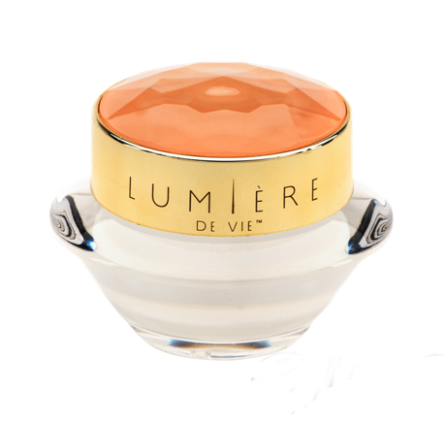
第4步：極緻妍亮逆齡面霜
step 4: INTENSE REJUVENATION CRÈME
主要成份：
五胜肽(Matrixyl synthe’6™)、Sytenol A（補骨脂酚）、GranactiveAR-1423、甘油、乙醯葡萄糖胺
效果：
撫平皺紋，使肌膚看來更柔滑、年輕
淡化色斑，使肌膚煥發明亮光彩
促進肌膚膠原蛋白和彈力蛋白正常健康
KEY INGREDIENTS:
Matrixyl® synthye’6, Sytenol A, Granactive AR-1423, Glycerin, Acetyl Glucosamine
Results you can expect:
Reduces the appearance of wrinkles for a smoother, younger-looking appearance
Helps reduce the appearance of age spots for a brighter-looking complexion
Supports normal, healthy collagen and elastin in the skin
HK12201; DC$350.00; SR$490.00; BV: 35

Slide 12
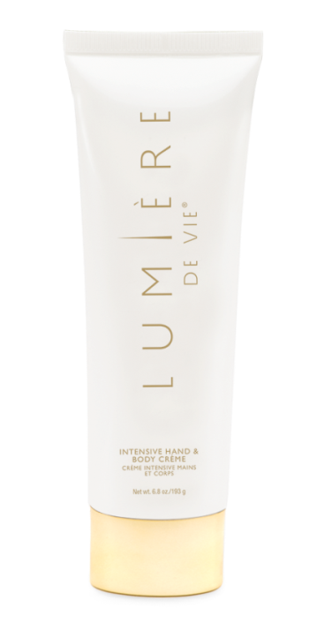
第4步：極緻妍亮手部及身體潤膚霜
step 4: HAND & BODY CRÈME
主要成份：
乳木果油、葵花籽油、椰子油
效果：
滋潤肌膚，改善肌膚粗糙和乾燥外表
含乳木果油、椰子油和葵花籽油，令肌膚外表柔軟嫩滑
易於被肌膚吸收，而不會感覺油膩
KEY INGREDIENTS
Shea Butter, Sunflower Seed Oil, Coconut Oil
RESULTS YOU CAN EXPECT:
Moisturizes to reduce the appearance of rough, dry skin
Contains shea butter, coconut oil and sunflower seed oil to keep skin looking soft and smooth
Absorbs into skin so it does not feel greasy
HK12205; DC$180.00; SR$251.00 BV: 17

Slide 13
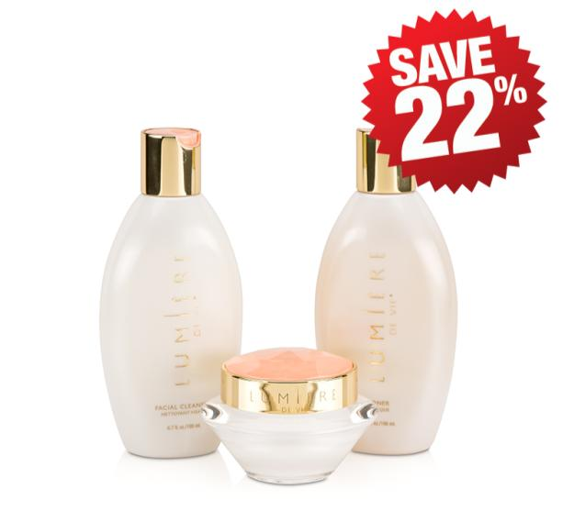
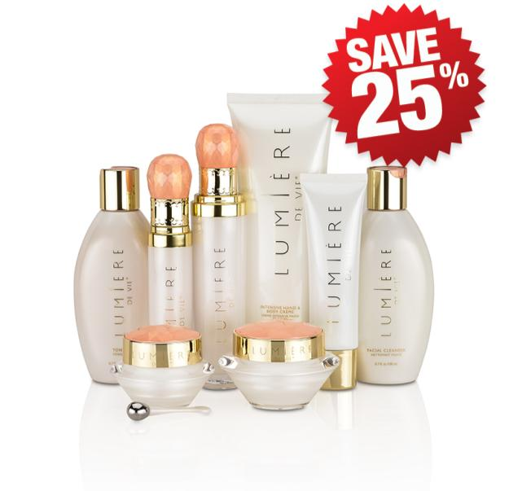
極緻妍亮基本組合
Skincare Value Kit
極緻妍亮尊貴組合
Full Regimen Kit
HK12210
DC$575.00; SR$805.00 BV: 50
HK12209
DC$1,735.00; SR$2,425.00 BV: 175

Slide 14
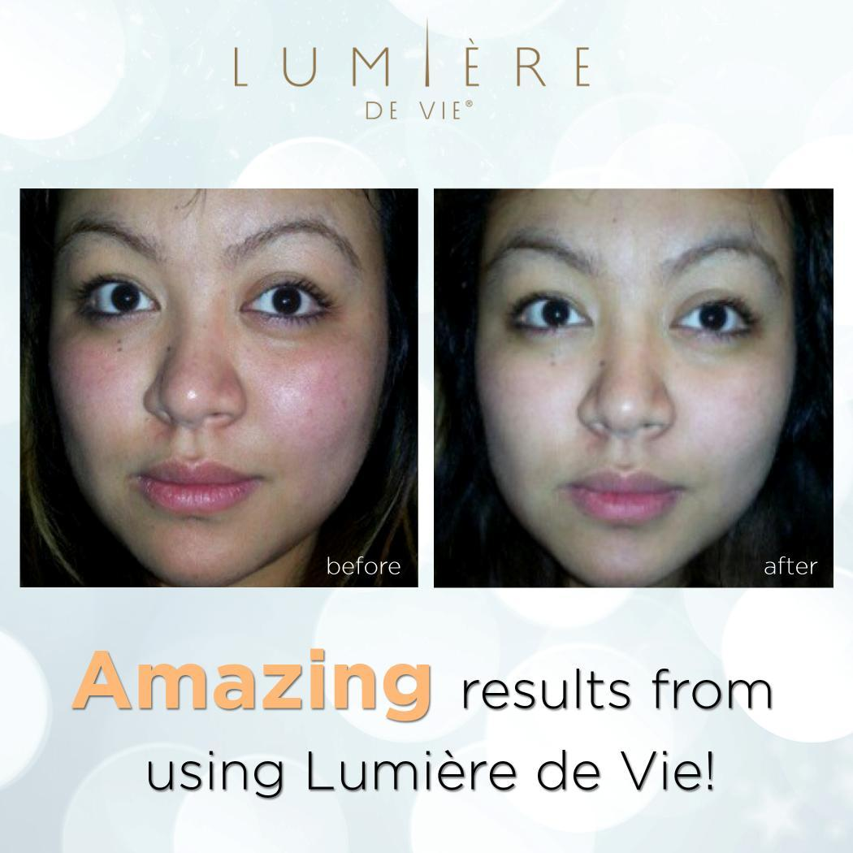

Slide 16
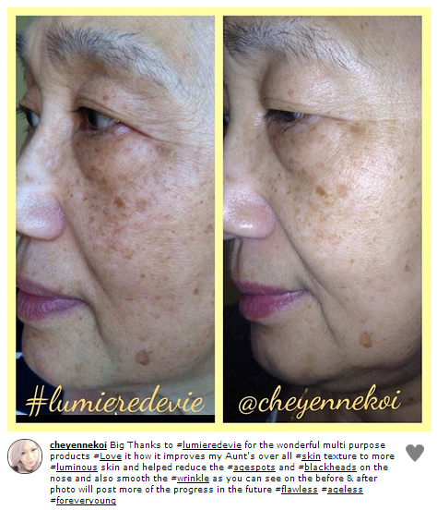
以上見證皆個別體驗，效果因人而異

Slide 17
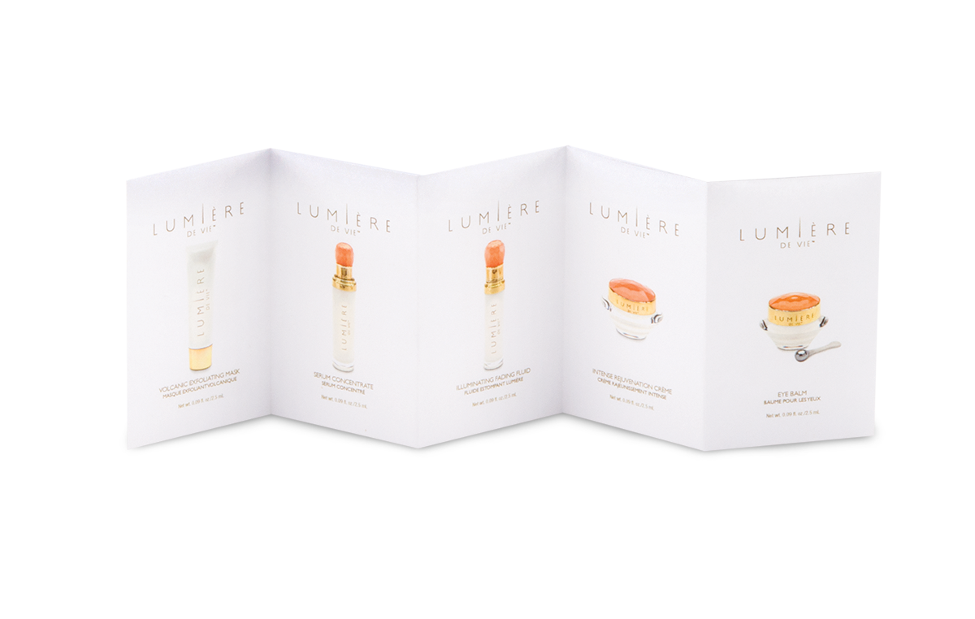
每個人都渴望體驗…
Everyone Wants This…
HK12206; DC$210.00; BV: 0

Slide 18
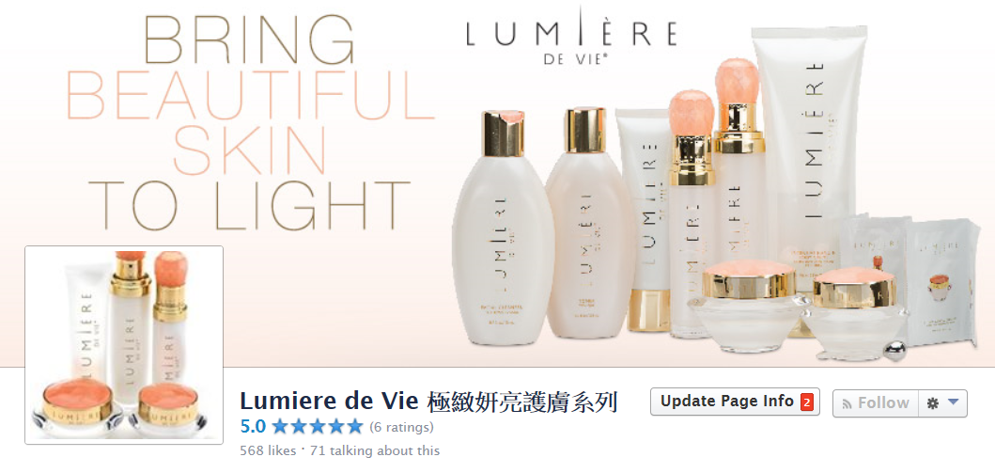
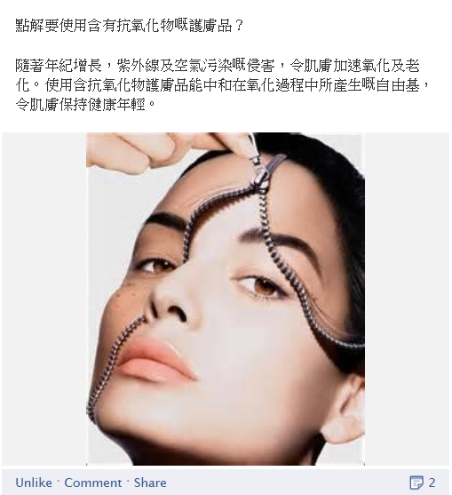
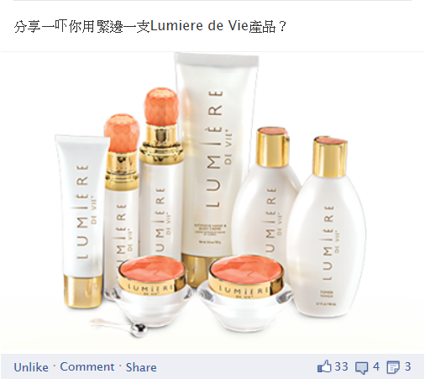
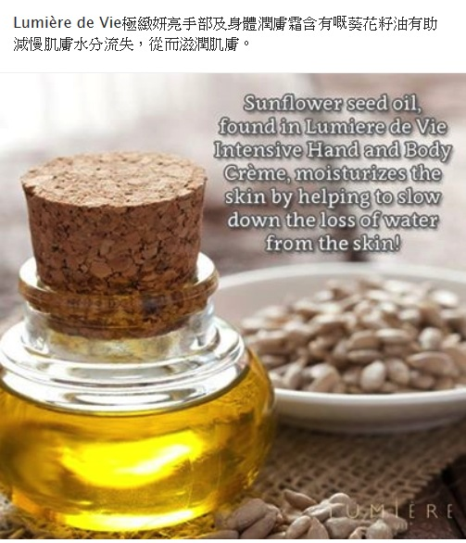
緊貼Lumière de Vie®極緻妍亮護膚系列最新資訊
Stay Connected with Lumière de Vie® https://www.facebook.com/Lumieremhk

Slide 19
極緻妍亮護膚系列

